Slide 1
Satellites:
Starlink | TLE and real satellites location
OneWeb | TLE and real satellites location | Planned orbit and generate satellites location | Generate both orbit and satellites
Amazon | TLE and real satellites location | Planned orbit and generate satellites location | Generate both orbit and satellites

Slide 2
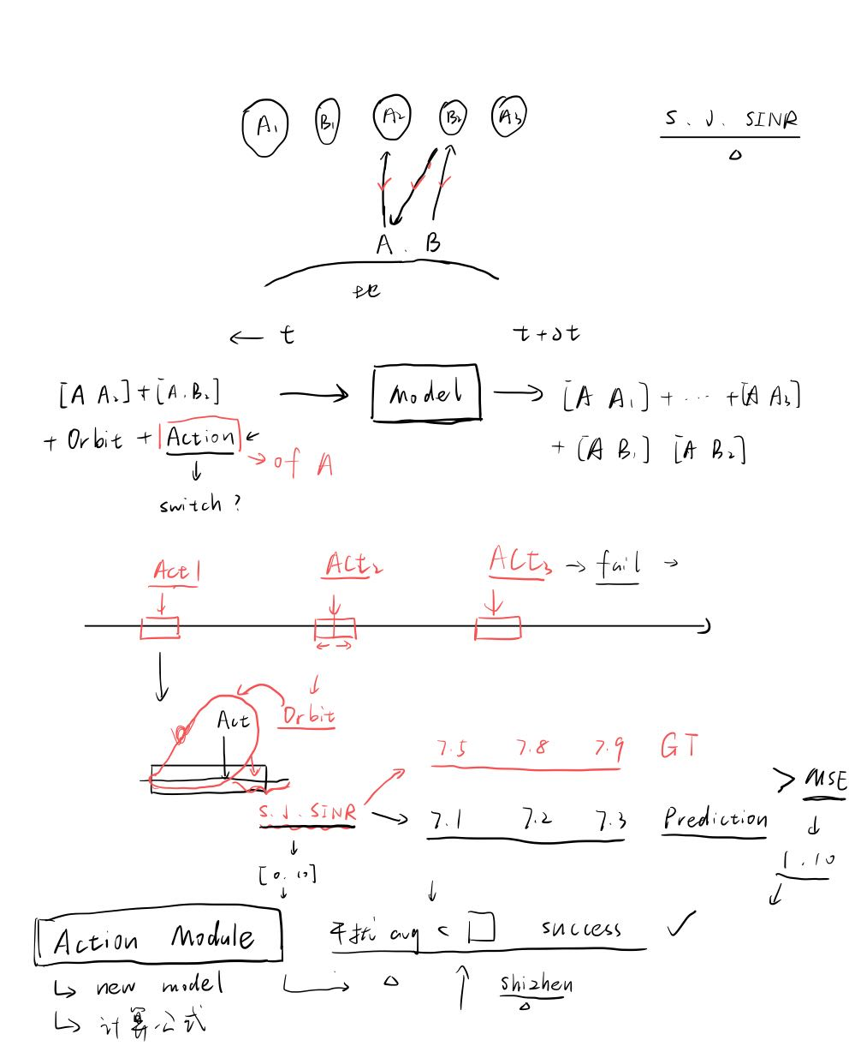
Model Input:
SINR; SNR; INR and Angle between A and A2, B2
Every time slots all satellites location during [T-n, T+m], T is current time
Check if its using register
3gpp beam search

Slide 3
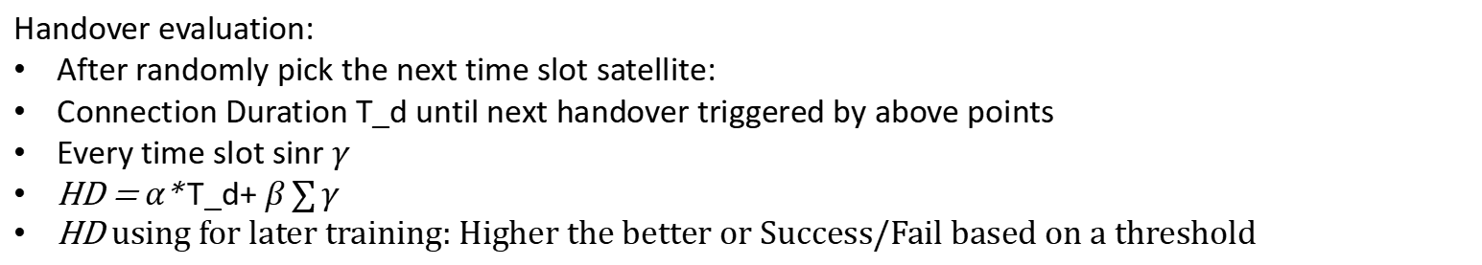
Data generation:
Initial:
Victim = “Starlink” ; Aggressor = “Amazon”
Aggressor choose certain strategy to pick satellites (longest connection above certain sinr_min)
Victim initial using some strategy (Can be same as above)
Satellite Handover Trigger:
For a fixed sliding time window T
Three SINR area: [sinr_minl, sinr_min+3], [sinr_min+3, sinr_min+6], [sinr_min+6, ~]
Correspoding 3, 2, 1 points, below sinr_min is 5 points
Accumulate to 10 points, Trigger the Victim hand over
Victim Handover strategy:
Not decided yet, for now using Random
Aggressor always using a fixed strategy
Handover evaluation:
After randomly pick the next time slot satellite:
Connection Duration T_d until next handover triggered by above points
Every time slot sinr $γ$
HD = $α$* T_d+ $β\sum{γ}$
HD using for later training: Higher the better or Success/Fail based on a threshold

